Slide 1
Google Data Analytics Professional Certification Capstone Project
Nathan Johnson

Slide 2
Brief
Goal. Cyclistic, a fictional bike-share company wants to convert its casual riders into annual members.
Task. Nathan Johnson is to assume the role of a junior data analyst and help Cyclistic achieve their goal by:
Analysing Cylistic’s ride-data to determine how casual riders and members use the service.
Deriving recommendations from that analysis.
Supporting recommendations with data insights and professional data visualisations.
Background.
Cyclistic is based in Chicago, U.S, and offers both electric and traditional bike hire.
Casual riders are non-members with each casual ride being covered by a single-ride pass or a full-day pass (electric bikes cannot be used with full-day passes).
Annual membership includes discounted rates for electric bike hire and fee-free durations for traditional bike rides.
Data.
Public data made available my Motivate International Inc. has been used to represent Cyclistic’s ride data under this license.
At the time of this project, the most recent 12 month’s data was used (April 2022 to March 2023).
The data can be accessed through this link.
Google Data Analytics Professional Certification Capstone Project – Nathan Johnson | The data used has been made available by Motivate International Inc. under this license and can be accessed through this link

Slide 3
Key Takeaways
Discontinuing Full-day Passes. Would drive casual riders to become members with no detriment to the user base – only 3.2% to 4.7% of non-electric bike casual rides are long enough for these rides to be cheaper on full-day passes than single-ride passes.
Fee-free Duration of Non-electric Bike Member Rides Increase. From 45 to 62 minutes would incentivise casual riders to purchase membership:
All non-electric bike casual rides would be covered by membership.
Except those non-electric bike casual rides that are exceptionally long (9.3%), greater than 62 minutes in duration (outliers).
Introducing a Fee-free Duration to Electric Bike Rides with Memberships. Would appeal to casual riders because:
At least 54.6% of casual rides are electric bike rides.
49.5% of member rides are electric bike rides.
Running costs could be mitigated by use of solar charging – investigate feasible fee-free duration period.
The Summer months could provide an opportune period as both sun-light and casual riding are maximal.
Offering Membership Trial Periods to Local Casual Riders. Would encourage them to sample membership benefits without an upfront cost:
Members are more likely to use the schemes’ bikes for commuting and casual riders are more likely to use the bikes for leisure.
A trial would introduce casual riders that have ridden for leisure to a cost-effective means of commuting, a justification for membership.
Google Data Analytics Professional Certification Capstone Project – Nathan Johnson | The data used has been made available by Motivate International Inc. under this license and can be accessed through this link

Slide 4
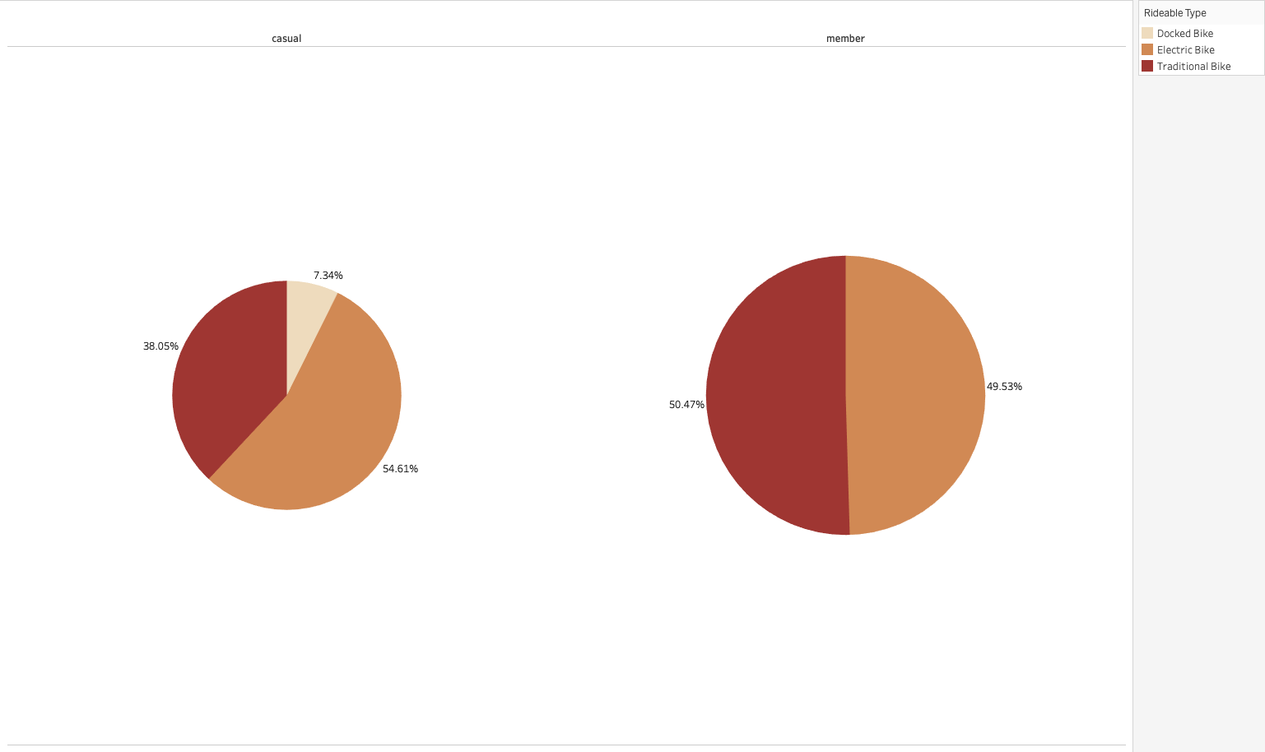
Introducing a Fee-free Duration to Electric Bike Rides with Memberships - Percentage of Rides for Each Bike Type
Hypothesis test with p-value < 0.001: The likelihood of a casual ride being an electric bike ride is greater than that of a member ride
Google Data Analytics Professional Certification Capstone Project – Nathan Johnson | The data used has been made available by Motivate International Inc. under this license and can be accessed through this link

Slide 5
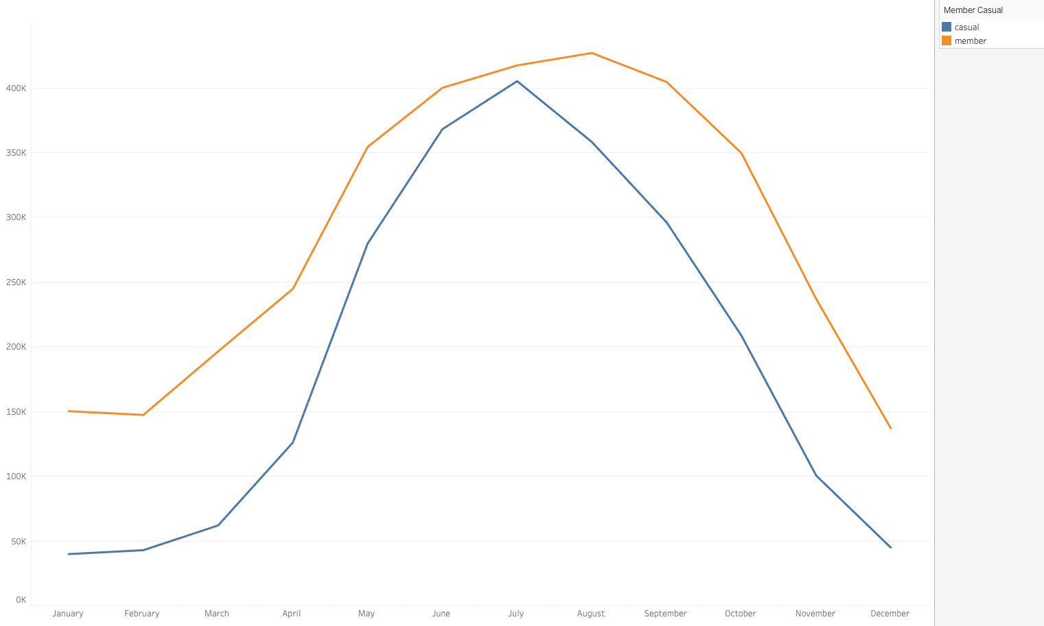
Commuting vs. Leisure Use - Number of Rides for Each Month of the Year
Hypothesis test with p-value < 0.001: Casual rides are more likely to start in Summer than member rides
Google Data Analytics Professional Certification Capstone Project – Nathan Johnson | The data used has been made available by Motivate International Inc. under this license and can be accessed through this link

Slide 6
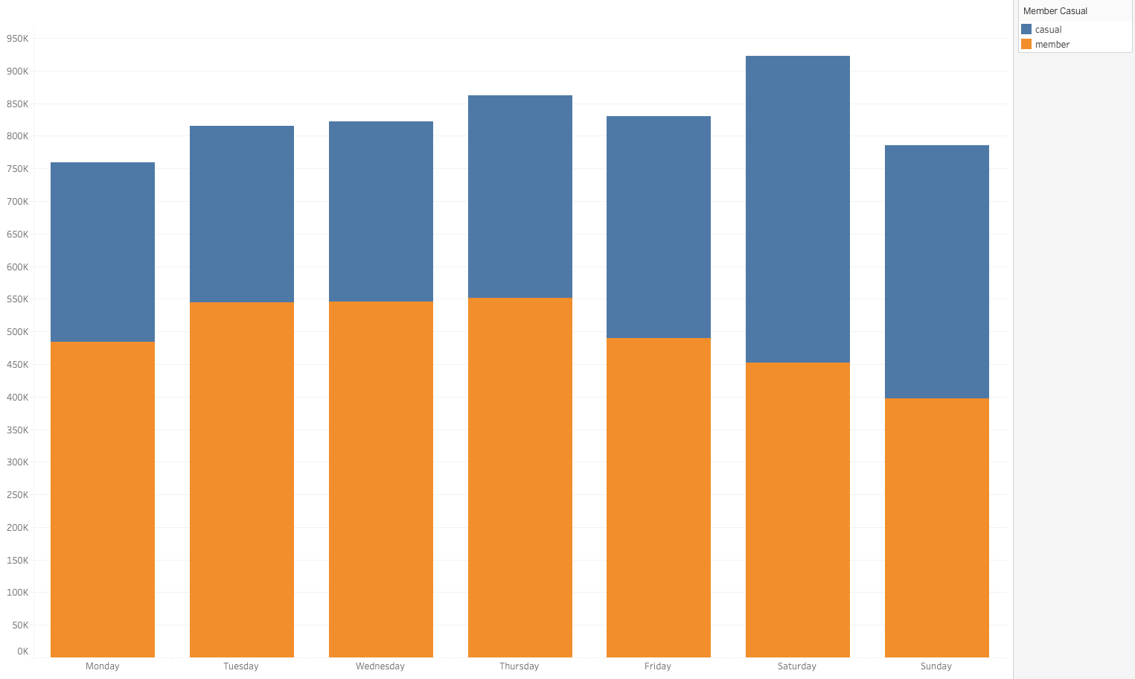
Commuting vs. Leisure Use - Number of Rides for Each Day of the Week
Hypothesis test with p-value < 0.001: Casual rides are more likely than member rides to start on weekends
Google Data Analytics Professional Certification Capstone Project – Nathan Johnson | The data used has been made available by Motivate International Inc. under this license and can be accessed through this link

Slide 7
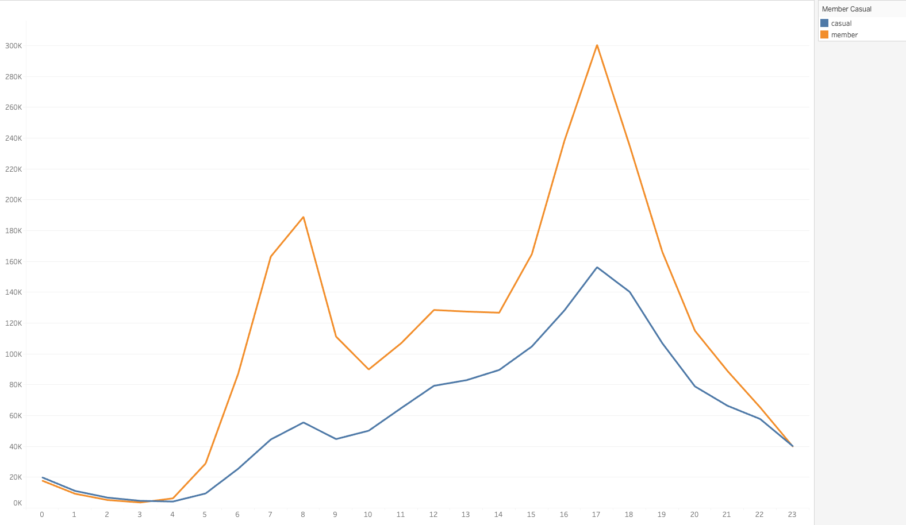
Commuting vs. Leisure Use - Number of Rides on Weekdays for Each Hour of the Day
Hypothesis test with p-value < 0.001: Member rides on weekdays are more likely to start between 6:00 & 9:00 than casual rides
Hypothesis test with p–value < 0.001:Member rides on weekdays are slightly more likely to start between 16:00 & 19:00 than casual rides
Google Data Analytics Professional Certification Capstone Project – Nathan Johnson | The data used has been made available by Motivate International Inc. under this license and can be accessed through this link

Slide 8
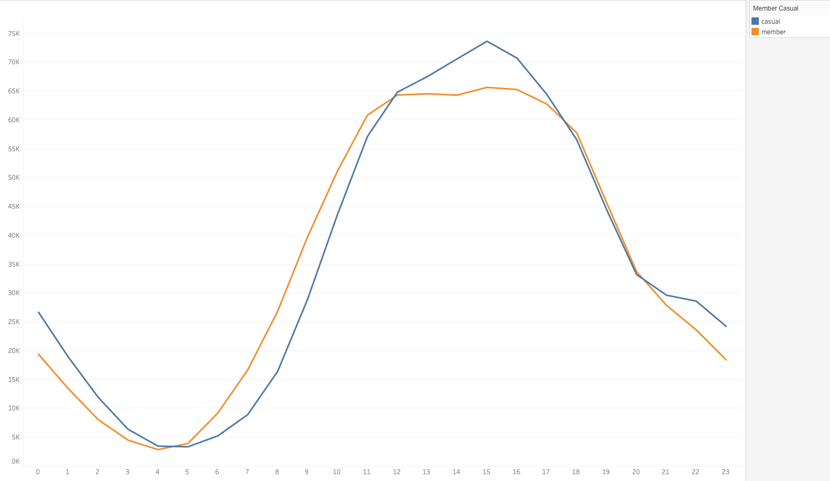
Commuting vs. Leisure Use - Number of Rides on Weekends for Each Hour of the Day
Hypothesis test with p-value < 0.001: Casual rides at weekends are slightly more likely to start between 12:00 & 17:00 than member rides
Google Data Analytics Professional Certification Capstone Project – Nathan Johnson | The data used has been made available by Motivate International Inc. under this license and can be accessed through this link

Slide 9
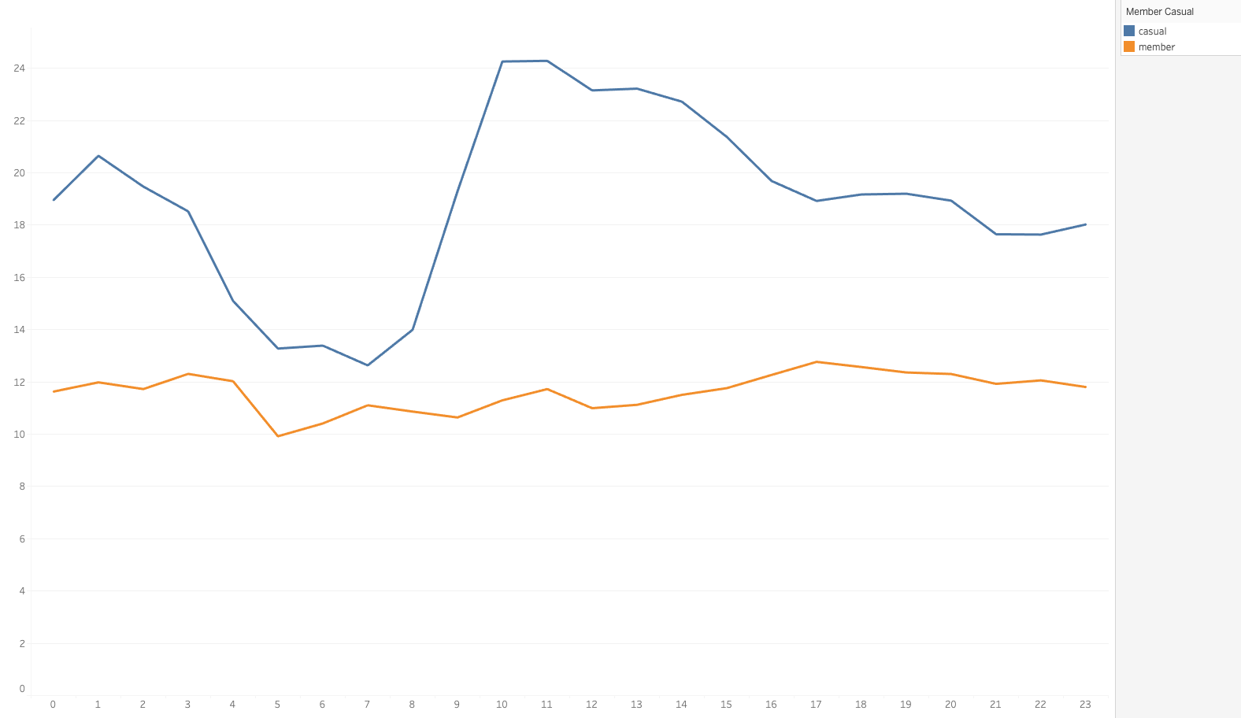
Commuting vs. Leisure Use - Average Ride Duration (Minutes) on Weekdays for Each Hour of the Day
Hypothesis test with p-value < 0.001: Even with exclusion of outliers, the duration of casual rides is greater on average than member rides
Hypothesis test with p-value < 0.001: Even with exclusion of outliers, the average duration of casual rides starting between 10:00 & 15:00 is at least 1.5 times as great as that of member rides
Google Data Analytics Professional Certification Capstone Project – Nathan Johnson | The data used has been made available by Motivate International Inc. under this license and can be accessed through this link

Slide 10
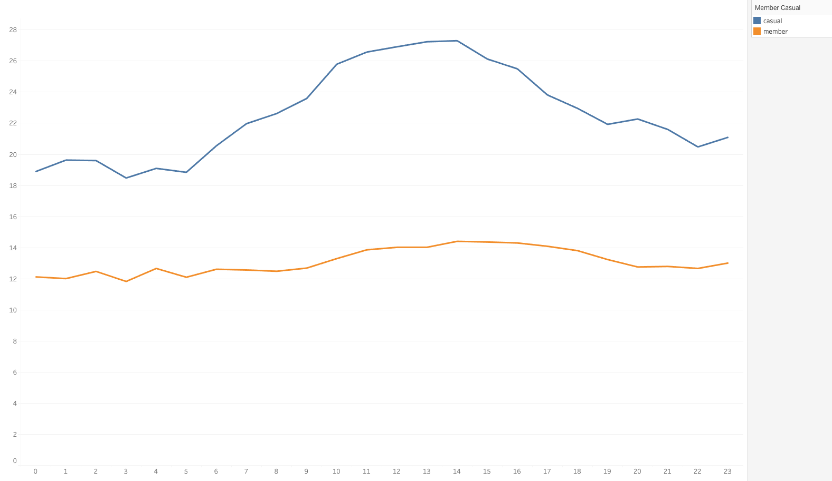
Commuting vs. Leisure Use - Average Ride Duration (Minutes) on Weekends for Each Hour of the Day
Hypothesis test with p-value < 0.001: Even with exclusion of outliers, the duration of casual rides is greater on average than member rides
Hypothesis test with p-value < 0.001: Even with exclusion of outliers, the average duration of casual rides starting between 10:00 & 15:00 is at least 1.5 times as great as that of member rides
Google Data Analytics Professional Certification Capstone Project – Nathan Johnson | The data used has been made available by Motivate International Inc. under this license and can be accessed through this link

Slide 11
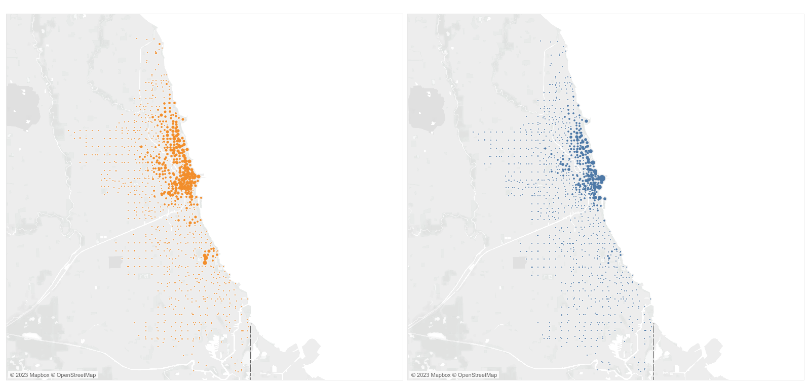
Commuting vs. Leisure Use - Percentage of Member and Casual Rides at Each Start Station
Relatively more member rides around University of Chicago and the hospitals in Little Village. Relatively more casual rides around the bird sanctuary, navy pier, and the Yacht club
Google Data Analytics Professional Certification Capstone Project – Nathan Johnson | The data used has been made available by Motivate International Inc. under this license and can be accessed through this link

Slide 12
Annex – Hypothesis Tests

Slide 13
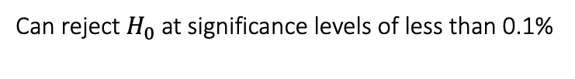
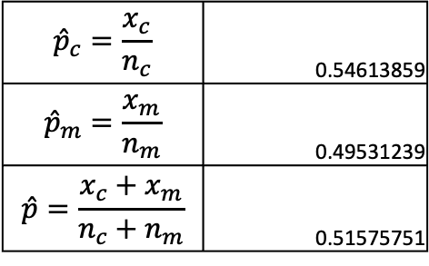
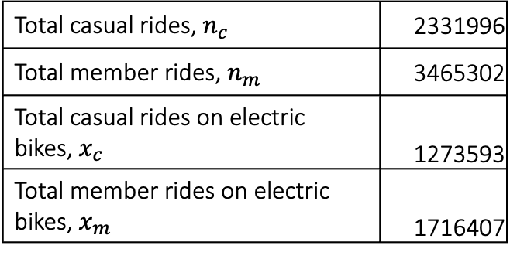
Is the Likelihood of a Casual Ride Being an Electric Bike Ride Greater Than That of a Member Ride?
Null Hypothesis, $H_{0}$ :${ p}_{m}≤p_{c}$ | Alternative Hypothesis, $H_{A}$ : $p_{m}>p_{c}$
Total casual rides, $n_{c}$ | 2331996
Total member rides, $n_{m}$ | 3465302
Total casual rides on electric bikes, $x_{c}$ | 1273593
Total member rides on electric bikes, $x_{m}$ | 1716407
$${\hat{p}}_{c}=\frac{x_{c}}{n_{c}}$$ | 0.54613859
$${\hat{p}}_{m}=\frac{x_{m}}{n_{m}}$$ | 0.49531239
$$\hat{p}=\frac{x_{c}+x_{m}}{n_{c}+n_{m}}$$ | 0.51575751
$$p\text{−}\text{value} =1−\operatorname{Pr}\left(z≤\frac{{\hat{p}}_{c}−{\hat{p}}_{m}}{\sqrt{\hat{p}\left(1−\hat{p}\right)\left(n_{c}^{−1}+n_{m}^{−1}\right)}} | { H}_{0} \right)=1−Pr\left(z≤\frac{5.08×{10}^{−2}}{4.23×{10}^{−4}} | H_{0}\right)<0.001$$
Can reject $H_{0}$ at significance levels of less than 0.1%
The likelihood of a casual ride being an electric bike ride is greater than that of a member ride
Google Data Analytics Professional Certification Capstone Project – Nathan Johnson | The data used has been made available by Motivate International Inc. under this license and can be accessed through this link

Slide 14
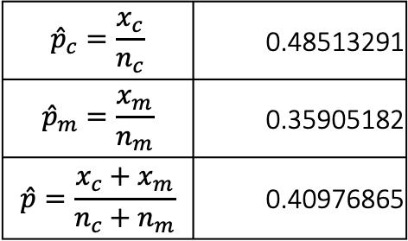
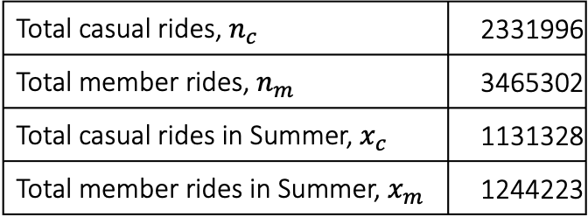
Are Casual Rides More Likely to Start in Summer Than Member Rides?
Null Hypothesis, $H_{0}$ :${ p}_{c}≤p_{m}$ | Alternative Hypothesis, $H_{A}$ : $p_{c}>p_{m}$
Total casual rides, $n_{c}$ | 2331996
Total member rides, $n_{m}$ | 3465302
Total casual rides in Summer, $x_{c}$ | 1131328
Total member rides in Summer, $x_{m}$ | 1244223
$${\hat{p}}_{c}=\frac{x_{c}}{n_{c}}$$ | 0.48513291
$${\hat{p}}_{m}=\frac{x_{m}}{n_{m}}$$ | 0.35905182
$$\hat{p}=\frac{x_{c}+x_{m}}{n_{c}+n_{m}}$$ | 0.40976865
$$p\text{−}\text{value} =1−\operatorname{Pr}\left(z≤\frac{{\hat{p}}_{c}−{\hat{p}}_{m}}{\sqrt{\hat{p}\left(1−\hat{p}\right)\left(n_{c}^{−1}+n_{m}^{−1}\right)}} | { H}_{0} \right)=1−Pr\left(z≤\frac{1.26×{10}^{−1}}{4.17×{10}^{−4}} | H_{0}\right)<0.001$$
Can reject $H_{0}$ at significance levels of less than 0.1%
Casual rides are more likely to start in Summer than member rides
Google Data Analytics Professional Certification Capstone Project – Nathan Johnson | The data used has been made available by Motivate International Inc. under this license and can be accessed through this link

Slide 15
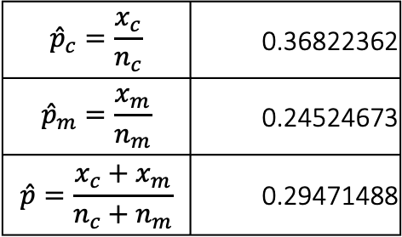
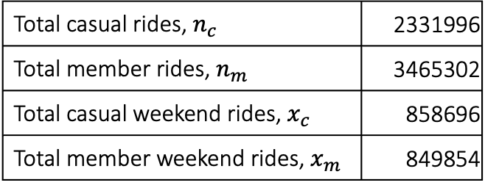
Are Casual Rides More Likely to Start on Weekends than Member Rides?
Null Hypothesis, $H_{0}$ :${ p}_{c}≤p_{m}$ | Alternative Hypothesis, $H_{A}$ : $p_{c}>p_{m}$
Total casual rides, $n_{c}$ | 2331996
Total member rides, $n_{m}$ | 3465302
Total casual weekend rides, $x_{c}$ | 858696
Total member weekend rides, $x_{m}$ | 849854
$${\hat{p}}_{c}=\frac{x_{c}}{n_{c}}$$ | 0.36822362
$${\hat{p}}_{m}=\frac{x_{m}}{n_{m}}$$ | 0.24524673
$$\hat{p}=\frac{x_{c}+x_{m}}{n_{c}+n_{m}}$$ | 0.29471488
$$p\text{−}\text{value} =1−\operatorname{Pr}\left(z≤\frac{{\hat{p}}_{c}−{\hat{p}}_{m}}{\sqrt{\hat{p}\left(1−\hat{p}\right)\left(n_{c}^{−1}+n_{m}^{−1}\right)}} | { H}_{0} \right)=1−Pr\left(z≤\frac{1.23×{10}^{−1}}{3.86×{10}^{−4}} | H_{0}\right)<0.001$$
Can reject $H_{0}$ at significance levels of less than 0.1%
Casual rides are more likely than member rides to start on weekends
Google Data Analytics Professional Certification Capstone Project – Nathan Johnson | The data used has been made available by Motivate International Inc. under this license and can be accessed through this link

Slide 16
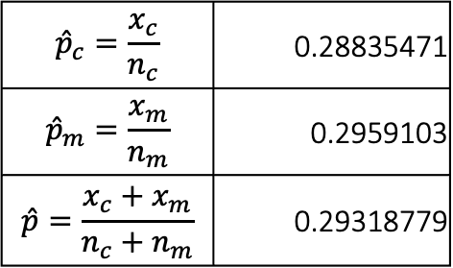
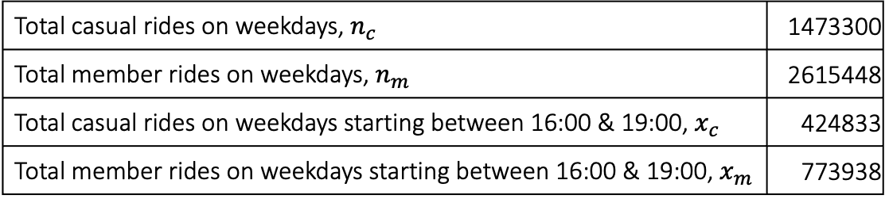
Are Member Rides on Weekdays More Likely to Start Between 16:00 & 19:00 Than Casual Rides?
Null Hypothesis, $H_{0}$ :${ p}_{m}≤p_{c}$ | Alternative Hypothesis, $H_{A}$ : $p_{m}>p_{c}$
Total casual rides on weekdays, $n_{c}$ | 1473300
Total member rides on weekdays, $n_{m}$ | 2615448
Total casual rides on weekdays starting between 16:00 & 19:00, $x_{c}$ | 424833
Total member rides on weekdays starting between 16:00 & 19:00, $x_{m}$ | 773938
$${\hat{p}}_{c}=\frac{x_{c}}{n_{c}}$$ | 0.28835471
$${\hat{p}}_{m}=\frac{x_{m}}{n_{m}}$$ | 0.2959103
$$\hat{p}=\frac{x_{c}+x_{m}}{n_{c}+n_{m}}$$ | 0.29318779
$$p\text{−}\text{value} =1−\operatorname{Pr}\left(z≤\frac{{\hat{p}}_{m}−{\hat{p}}_{c}}{\sqrt{\hat{p}\left(1−\hat{p}\right)\left(n_{c}^{−1}+n_{m}^{−1}\right)}} | { H}_{0} \right)=1−Pr\left(z≤\frac{7.56×{10}^{−3}}{4.69×{10}^{−4}} | H_{0}\right)<0.001$$
Can reject $H_{0}$ at significance levels of less than 0.1%
Member rides on weekdays are slightly more likely to start between 16:00 & 19.00 than casual rides
Google Data Analytics Professional Certification Capstone Project – Nathan Johnson | The data used has been made available by Motivate International Inc. under this license and can be accessed through this link

Slide 17
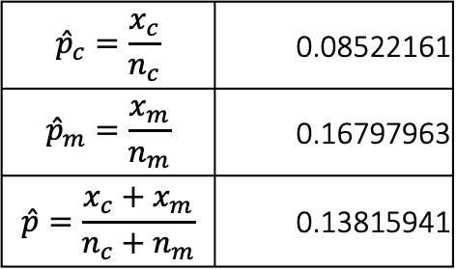
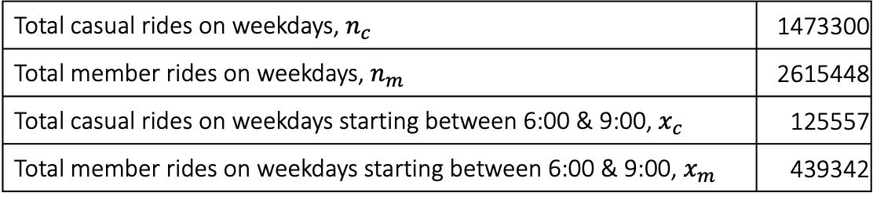
Are Member Rides on Weekdays More Likely to Start Between 6:00 & 9:00 Than Casual Rides?
Null Hypothesis, $H_{0}$ :${ p}_{m}≤p_{c}$ | Alternative Hypothesis, $H_{A}$ : $p_{m}>p_{c}$
Total casual rides on weekdays, $n_{c}$ | 1473300
Total member rides on weekdays, $n_{m}$ | 2615448
Total casual rides on weekdays starting between 6:00 & 9:00, $x_{c}$ | 125557
Total member rides on weekdays starting between 6:00 & 9:00, $x_{m}$ | 439342
$${\hat{p}}_{c}=\frac{x_{c}}{n_{c}}$$ | 0.08522161
$${\hat{p}}_{m}=\frac{x_{m}}{n_{m}}$$ | 0.16797963
$$\hat{p}=\frac{x_{c}+x_{m}}{n_{c}+n_{m}}$$ | 0.13815941
$$p\text{−}\text{value} =1−\operatorname{Pr}\left(z≤\frac{{\hat{p}}_{m}−{\hat{p}}_{c}}{\sqrt{\hat{p}\left(1−\hat{p}\right)\left(n_{c}^{−1}+n_{m}^{−1}\right)}} | { H}_{0} \right)=1−Pr\left(z≤\frac{8.28×{10}^{−2}}{3.55×{10}^{−4}} | H_{0}\right)<0.001$$
Can reject $H_{0}$ at significance levels of less than 0.1%
Member rides on weekdays are more likely to start between 6:00 & 9:00 than casual rides
Google Data Analytics Professional Certification Capstone Project – Nathan Johnson | The data used has been made available by Motivate International Inc. under this license and can be accessed through this link

Slide 18
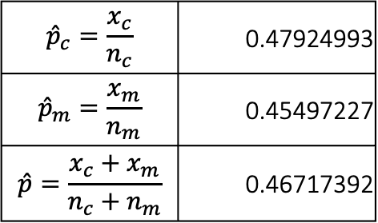
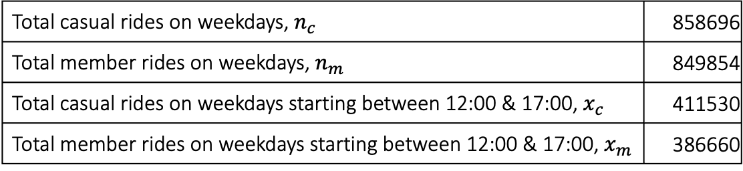
Are Casual Rides at Weekends More Likely to Start Between 12:00 & 17:00 than Member Rides?
Null Hypothesis, $H_{0}$ :${ p}_{c}≤p_{m}$ | Alternative Hypothesis, $H_{A}$ : $p_{c}>p_{m}$
Total casual rides on weekdays, $n_{c}$ | 858696
Total member rides on weekdays, $n_{m}$ | 849854
Total casual rides on weekdays starting between 12:00 & 17:00, $x_{c}$ | 411530
Total member rides on weekdays starting between 12:00 & 17:00, $x_{m}$ | 386660
$${\hat{p}}_{c}=\frac{x_{c}}{n_{c}}$$ | 0.47924993
$${\hat{p}}_{m}=\frac{x_{m}}{n_{m}}$$ | 0.45497227
$$\hat{p}=\frac{x_{c}+x_{m}}{n_{c}+n_{m}}$$ | 0.46717392
$$p\text{−}\text{value} =1−\operatorname{Pr}\left(z≤\frac{{\hat{p}}_{c}−{\hat{p}}_{m}}{\sqrt{\hat{p}\left(1−\hat{p}\right)\left(n_{c}^{−1}+n_{m}^{−1}\right)}} | { H}_{0} \right)=1−Pr\left(z≤\frac{2.43×{10}^{−2}}{7.63×{10}^{−4}} | H_{0}\right)<0.001$$
Can reject $H_{0}$ at significance levels of less than 0.1%
Casual rides at weekends are slightly more likely to start between 12:00 & 17:00 than member rides
Google Data Analytics Professional Certification Capstone Project – Nathan Johnson | The data used has been made available by Motivate International Inc. under this license and can be accessed through this link

Slide 19
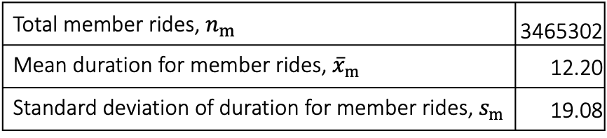
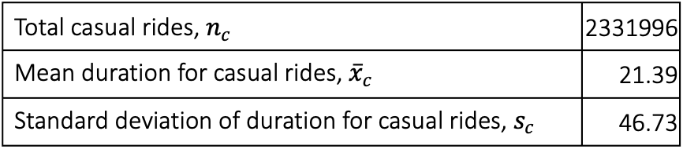
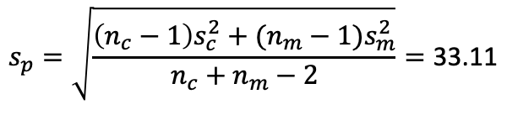
Is the Average Ride Duration Greater for Casual Rides than Member Rides?
Null Hypothesis, $H_{0}$ :$μ_{c}≤μ_{m}$ | Alternative Hypothesis, $H_{A}$ : $μ_{c}>μ_{m}$
Total casual rides, $n_{c}$ | 2331996
Mean duration for casual rides, ${\overline{x}}_{c}$ | 21.39
Standard deviation of duration for casual rides, $s_{c}$ | 46.73
Total member rides, $n_{m}$ | 3465302
Mean duration for member rides, ${\overline{x}}_{m}$ | 12.20
Standard deviation of duration for member rides, $s_{m}$ | 19.08
$$s_{p}=\sqrt{\frac{\left(n_{c}−1\right)s_{c}^{2}+(n_{m}−1)s_{m}^{2}}{n_{c}+n_{m}−2}}=\text{33.1}\text{1}$$
$$p\text{−}\text{value} =1−\operatorname{Pr}\left(t_{n_{c}+n_{m}−2}≤\frac{{\overline{x}}_{c}−{\overline{x}}_{m}}{s_{p}\sqrt{n_{c}^{−1}+n_{m}^{−1}}} | { H}_{0} \right)=1−\operatorname{Pr}\left(t_{n_{c}+n_{m}−2}≤\frac{9.19}{2.38×{10}^{−5}} | { H}_{0} \right)<0.001$$
Can reject $H_{0}$ at significance levels of less than 0.1%
On average, the duration of casual rides is greater than member rides
Google Data Analytics Professional Certification Capstone Project – Nathan Johnson | The data used has been made available by Motivate International Inc. under this license and can be accessed through this link

Slide 20
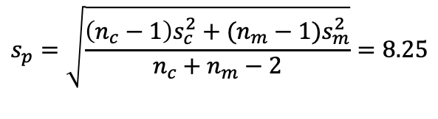
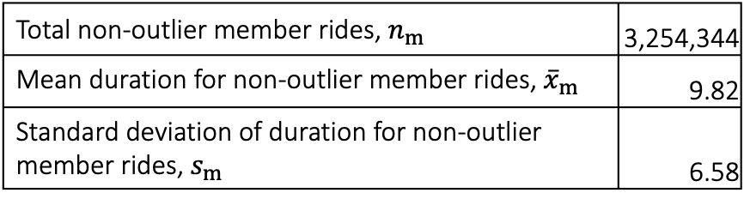
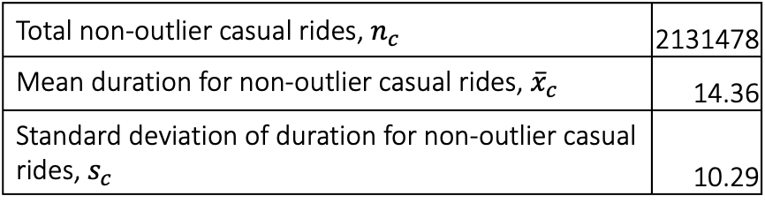
Is the Average Ride Duration Greater for Casual Rides than Member Rides? (Excluding Outliers)
Null Hypothesis, $H_{0}$ :$μ_{c}≤μ_{m}$ | Alternative Hypothesis, $H_{A}$ : $μ_{c}>μ_{m}$
Total non-outlier casual rides, $n_{c}$ | 2131478
Mean duration for non-outlier casual rides, ${\overline{x}}_{c}$ | 14.36
Standard deviation of duration for non-outlier casual rides, $s_{c}$ | 10.29
Total non-outlier member rides, $n_{m}$ | 3,254,344
Mean duration for non-outlier member rides, ${\overline{x}}_{m}$ | 9.82
Standard deviation of duration for non-outlier member rides, $s_{m}$ | 6.58
$$s_{p}=\sqrt{\frac{\left(n_{c}−1\right)s_{c}^{2}+(n_{m}−1)s_{m}^{2}}{n_{c}+n_{m}−2}}=\text{8.25}$$
$$p\text{−}\text{value} =1−\operatorname{Pr}\left(t_{n_{c}+n_{m}−2}≤\frac{{\overline{x}}_{c}−{\overline{x}}_{m}}{s_{p}\sqrt{n_{c}^{−1}+n_{m}^{−1}}} | { H}_{0} \right)=1−\operatorname{Pr}\left(t_{n_{c}+n_{m}−2}≤\frac{4.54}{7.27×{10}^{−3}} | { H}_{0} \right)<0.001$$
Can reject $H_{0}$ at significance levels of less than 0.1%
Even with exclusion of outliers, the duration of casual rides is greater on average than member rides
Google Data Analytics Professional Certification Capstone Project – Nathan Johnson | The data used has been made available by Motivate International Inc. under this license and can be accessed through this link

Slide 21
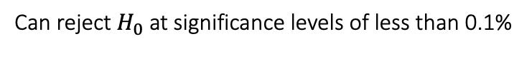
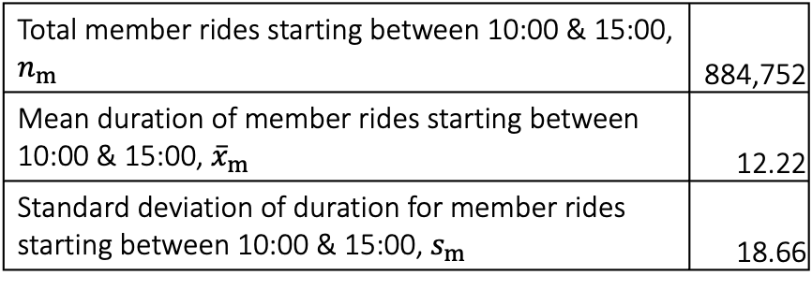
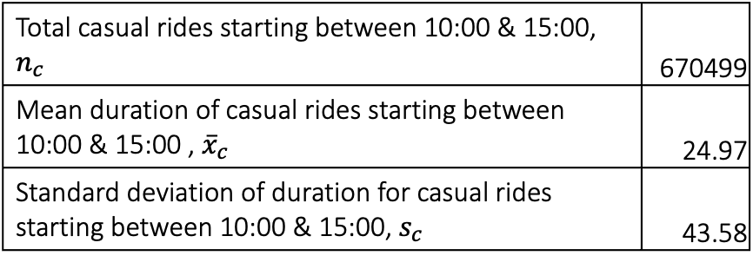
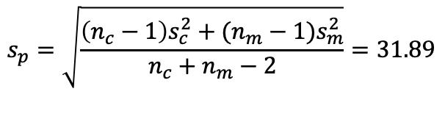
Is the Average Duration of Casual Rides Starting Between 10:00 & 15:00 at Least Twice as Great as That of Member Rides?
Null Hypothesis, $H_{0}$ :$μ_{c}≤{2μ}_{m}$ | Alternative Hypothesis, $H_{A}$ : $μ_{c}>{2μ}_{m}$
Total casual rides starting between 10:00 & 15:00, $n_{c}$ | 670499
Mean duration of casual rides starting between 10:00 & 15:00 , ${\overline{x}}_{c}$ | 24.97
Standard deviation of duration for casual rides starting between 10:00 & 15:00, $s_{c}$ | 43.58
Total member rides starting between 10:00 & 15:00, $n_{m}$ | 884,752
Mean duration of member rides starting between 10:00 & 15:00, ${\overline{x}}_{m}$ | 12.22
Standard deviation of duration for member rides starting between 10:00 & 15:00, $s_{m}$ | 18.66
$$s_{p}=\sqrt{\frac{\left(n_{c}−1\right)s_{c}^{2}+(n_{m}−1)s_{m}^{2}}{n_{c}+n_{m}−2}}=31.89$$
$$p\text{−}\text{value} =1−\operatorname{Pr}\left(t_{n_{c}+n_{m}−2}≤\sqrt{\frac{{\overline{x}}_{c}−{2\overline{x}}_{m}}{s_{p}\left(n_{c}^{−1}+4n_{m}^{−1}\right)}} | { H}_{0} \right)=1−\operatorname{Pr}\left(t_{n_{c}+n_{m}−2}≤\sqrt{\frac{5.22×{10}^{−1}}{6.12×{10}^{−3}}} | { H}_{0} \right)<0.001$$
Can reject $H_{0}$ at significance levels of less than 0.1%
The average duration of casual rides starting between 10:00 & 15:00 is at least twice as great as that of member rides
Google Data Analytics Professional Certification Capstone Project – Nathan Johnson | The data used has been made available by Motivate International Inc. under this license and can be accessed through this link

Slide 22
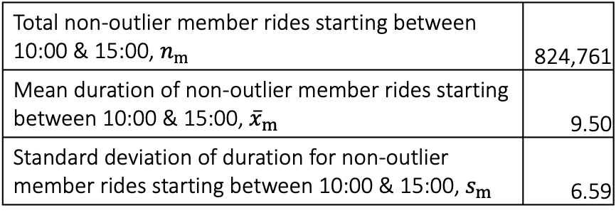
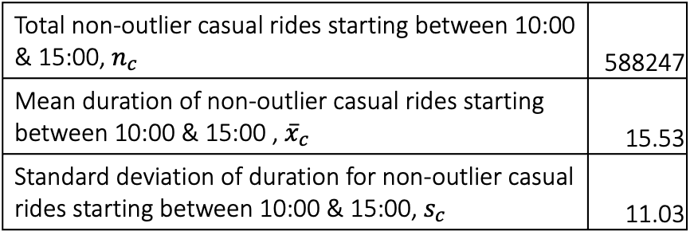
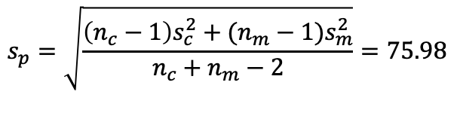
Is the Average Duration of Casual Rides Starting Between 10:00 & 15:00 at Least 1.5 Times as Great as That of Member Rides? (Excluding Outliers)
Null Hypothesis, $H_{0}$ :$μ_{c}≤{1.5μ}_{m}$ | Alternative Hypothesis, $H_{A}$ : $μ_{c}>{1.5μ}_{m}$
Total non-outlier casual rides starting between 10:00 & 15:00, $n_{c}$ | 588247
Mean duration of non-outlier casual rides starting between 10:00 & 15:00 , ${\overline{x}}_{c}$ | 15.53
Standard deviation of duration for non-outlier casual rides starting between 10:00 & 15:00, $s_{c}$ | 11.03
Total non-outlier member rides starting between 10:00 & 15:00, $n_{m}$ | 824,761
Mean duration of non-outlier member rides starting between 10:00 & 15:00, ${\overline{x}}_{m}$ | 9.50
Standard deviation of duration for non-outlier member rides starting between 10:00 & 15:00, $s_{m}$ | 6.59
$$s_{p}=\sqrt{\frac{\left(n_{c}−1\right)s_{c}^{2}+(n_{m}−1)s_{m}^{2}}{n_{c}+n_{m}−2}}=75.98$$
$$p\text{−}\text{value} =1−\operatorname{Pr}\left(t_{n_{c}+n_{m}−2}≤\sqrt{\frac{{\overline{x}}_{c}−{2\overline{x}}_{m}}{s_{p}\left(n_{c}^{−1}+4n_{m}^{−1}\right)}} | { H}_{0} \right)=1−\operatorname{Pr}\left(t_{n_{c}+n_{m}−2}≤\sqrt{\frac{1.28}{3.36×{10}^{−4}}} | { H}_{0} \right)<0.001$$
Can reject $H_{0}$ at significance levels of less than 0.1%
Excluding outliers, the average duration of casual rides starting between 10:00 & 15:00 is at least 1.5 times as great as that of member rides
Google Data Analytics Professional Certification Capstone Project – Nathan Johnson | The data used has been made available by Motivate International Inc. under this license and can be accessed through this link

